Slide 1

REST architecture and principles
InConcept Labs Learning series

Slide 2
Agenda
What is a REST
Architectural constraints
RESTful API HTTP methods
Rules of REST API
REST Resource Naming Guide

Slide 3
What is a REST
Representational state transfer (REST) is a way to create, read, update or delete information on a server using simple HTTP calls.
REST uses HTTP for all four CRUD (Create/Read/Update/Delete) operations.
REST is a software architectural style consisting of a coordinated set of architectural constraints applied to components, connectors, and data elements, within a distributed hypermedia system.
REST ignores the details of component implementation and protocol syntax in order to focus on the roles of components, the constraints upon their interaction with other components, and their interpretation of significant data elements.^{[1][2]}

Slide 4
Architectural constraints
Client-Server
Stateless
Cacheable
Uniform interface
Layered system
Code on demand (optional)

Slide 5
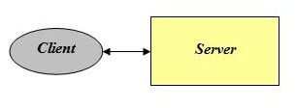
Architectural constraint N1 – Client-Server
The client-server constraint is based on a principle in software known as the separation of concerns. It simply requires the existence of a client component that sends requests and a server component that receives requests. After receiving a request the server may also issue a response to the client.
The properties induced by this constraint are portability, evolvability, and scalability.
Separates user interface concerns from data storage concerns.
Improves portability of interface across multiple platforms.
Improves scalability by simplifying server components.
Allows the components to evolve independently.

Slide 6
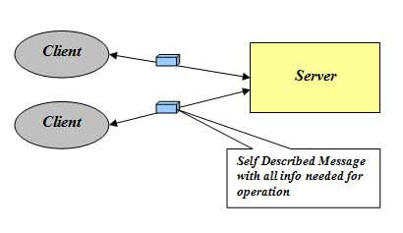
Constraint N2 - Stateless
The stateless communication constraint requires every request to contain all of the information needed to interpret that request. This increases
visibility
reliability
scalability
but also decreases performance because of the larger messages required for stateless communication.
no client context being stored on the server between requests.
each request from any client contains all the information necessary to service the request
session state is held in the client.

Slide 7
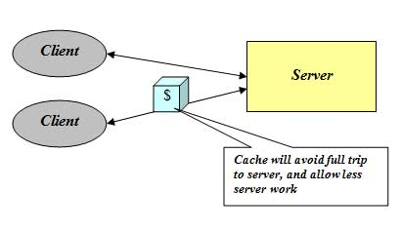
Constraints N3 - Cacheable
The caching constraint states that a REST architecture must have some mechanism for labeling messages as cacheable or non-cacheable.
This gives a client or intermediary component permission to cache and reissue a message which increases efficiency, scalability, and performance.
Data within a response to a request is implicitly or explicitly labeled as cacheable or non cacheable.
If a response is cacheable, then a client cache is given the right to reuse that response data for later, equivalent requests.
Improves efficiency, scalability and user perceived performance.
Tradeoff: cacheable constraint reduces Reliability.

Slide 8
Constraint N4 - Uniform interface constraint
The uniform interface constraint defines the interface between clients and servers. It simplifies and decouples the architecture, which enables each part to evolve independently.
The four guiding principles of this interface are:
1) Resource identification
Each resource must have a specific and cohesive URI to be made available.
2) Resource Representations
Is how the resource will return to the client. This representation can be in HTML, XML, JSON, TXT, and more.
3) Self-descriptive messages
Each message includes enough information to describe how to process the message. The passage of meta information is needed (metadata) in the request and response. Some of this information are HTTP response code, Host, Content-Type etc.

Slide 9
Constraint N4 - Uniform interface constraint - HATEOAS
4) Hypermedia as the engine of application state (HATEOAS)
It need to include links for each response so that client can discover other resources easily.
{
"departmentId": 10,
"departmentName": "Administration",
"locationId": 1700,
"managerId": 200,
"links": [
{
"href": "10/employees",
"rel": "employees",
"type" : "GET"
}
]
}
Good article to read about HATEOAS
https://pulsejet.github.io/blog/posts/hateoas/

Slide 10
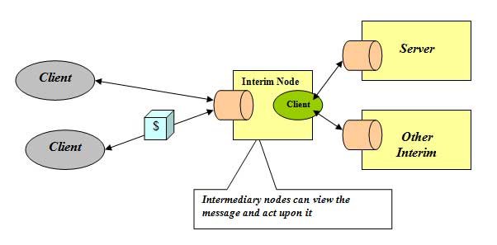
Constraint N5 - Layered system
A client cannot ordinarily tell whether it is connected directly to the end server, or to an intermediary along the way. Intermediary servers may improve system scalability by enabling load-balancing and by providing shared caches. They may also enforce security policies.
The layered system constraint defines a REST architecture as hierarchical layers of components, limited to communication with their immediate neighbors.
improves simplicity by separating concerns
improves extensibility by using layers as a mechanism to isolate legacy components
Scalability is increased by providing the capacity for intermediary components that act as caches or load balancers.
The trade off with this constraint is reduced performance from the increased levels of indirection associated with multiple layers.

Slide 11
Constraint N6 – Code on demand (optional)
This constraint is optional — an API can be RESTful even without providing code on demand.
Code on demand allows a client to download and execute code from a server. This allows the client functionality to be extended after initial deployment of the application. This has an effect on simplicity as well, because it promotes the reduced coupling of features.
Servers can temporarily extend or customize the functionality of a client by the transfer of executable code. Examples of this may include compiled components such as Java applets and client-side scripts such as JavaScript. "Code on demand" is the only optional constraint of the REST architecture.

Slide 12
RESTful API HTTP methods
GET: Retrieves one or more resources identified by the request URI and it can cache the information receive.
POST: Create a resource from the submission of a request and response is not cacheable in this case. This method is unsafe if no security is applied to the endpoint as it would allow anyone to create a random resource by submission.
PUT: Update an existing resource on the server specified by the request URI.
DELETE: Delete an existing resource on the server specified by the request URI. It always return an appropriate HTTP status for every request.

Slide 13
RESTful API HTTP methods - GET
HTTP Verb | Entire Collection (e.g. /customers) | Specific Item (e.g. /customers/{id})
GET | 200 (OK), list of customers. Use pagination, sorting and filtering to navigate big lists. | 200 (OK), single customer. 404 (Not Found), if ID not found or invalid.
The HTTP GET method is used to retrieve (or read) a representation of a resource. In the “happy” (or non-error) path, GET returns a representation in XML or JSON and an HTTP response code of 200 (OK). In an error case, it most often returns a 404 (NOT FOUND) or 400 (BAD REQUEST).
According to the design of the HTTP specification, GET (along with HEAD) requests are used only to read data and not change it.
Do not expose unsafe operations via GET—it should never modify any resources on the server.
Examples:
GET http://www.example.com/customers/12345
GET http://www.example.com/customers/12345/orders

Slide 14
RESTful API HTTP methods - POST
HTTP Verb | Entire Collection (e.g. /customers) | Specific Item (e.g. /customers/{id})
POST | 201 (Created), 'Location' header with link to /customers/{id} containing new ID. | 404 (Not Found).
The POST verb is most-often utilized for creation of new resources. In particular, it's used to create subordinate resources. That is, subordinate to some other (e.g. parent) resource. In other words, when creating a new resource, POST to the parent and the service takes care of associating the new resource with the parent, assigning an ID (new resource URI), etc.
On successful creation, return HTTP status 201, returning a Location header with a link to the newly-created resource with the 201 HTTP status.
Making two identical POST requests will most-likely result in two resources containing the same information.
Examples:
POST http://www.example.com/customers
POST http://www.example.com/customers/12345/orders

Slide 15
RESTful API HTTP methods - PUT
HTTP Verb | Entire Collection (e.g. /customers) | Specific Item (e.g. /customers/{id})
PUT | 404 (Not Found), unless you want to update/replace every resource in the entire collection. | 200 (OK) or 204 (No Content). 404 (Not Found), if ID not found or invalid.
PUT-ing to a known resource URI with the request body containing the newly-updated representation of the original resource.
However, PUT can also be used to create a resource in the case where the resource ID is chosen by the client instead of by the server. In other words, if the PUT is to a URI that contains the value of a non-existent resource ID. Again, the request body contains a resource representation.
On successful update, return 200 (or 204 if not returning any content in the body) from a PUT. If using PUT for create, return HTTP status 201 on successful creation. A body in the response is optional—providing one consumes more bandwidth. It is not necessary to return a link via a Location header in the creation case since the client already set the resource ID.

Slide 16
RESTful API HTTP methods - DELETE
HTTP Verb | Entire Collection (e.g. /customers) | Specific Item (e.g. /customers/{id})
DELETE | 404 (Not Found), unless you want to delete the whole collection—not often desirable. | 200 (OK). 404 (Not Found), if ID not found or invalid.
DELETE is pretty easy to understand. It is used to delete a resource identified by a URI.
On successful deletion, return HTTP status 200 (OK) along with a response body, perhaps the representation of the deleted item (often demands too much bandwidth), or a wrapped response (see Return Values below). Either that or return HTTP status 204 (NO CONTENT) with no response body.
HTTP-spec-wise, DELETE operations are idempotent. If you DELETE a resource, it's removed. Repeatedly calling DELETE on that resource ends up the same: the resource is gone.
Examples:
DELETE http://www.example.com/customers/12345
DELETE http://www.example.com/customers/12345/orders
DELETE http://www.example.com/bucket/sample

Slide 17
Rules of REST API

Slide 18
Idempotent REST APIs
In the context of REST APIs, when making multiple identical requests has the same effect as making a single request – then that REST API is called idempotent.
When you design REST APIs, you must realize that API consumers can make mistakes. They can write client code in such a way that there can be duplicate requests as well. These duplicate requests may be unintentional as well as intentional some time (e.g. due to timeout or network issues). You have to design fault-tolerant APIs in such a way that duplicate requests do not leave the system unstable.
GET, PUT, DELETE, HEAD, OPTIONS and TRACE are idempotent
POST - is not idempotent – every time it will create a new entity
PUT - is idempotent, first time it will make a change, next calls will just overwrite
DELETE – is idempotent, however calling it second time will return 404

Slide 19
REST API Versioning
When to Version
a change in the format of the response data for one or more calls
a change in the response type (i.e. changing an integer to a float)
removing any part of the API.
How to Version
1) URI Versioning
http://api.example.com/v1
http://apiv1.example.com
2)Versioning using Accept header
Accept: application/vnd.example.v1+json
Accept: application/vnd.example+json;version=1.0

Slide 20
REST Resource Naming Guide

Slide 21
REST Resource Naming Guide - document
A document resource is a singular concept that is akin to an object instance or database record. In REST, you can view it as a single resource inside resource collection. A document’s state representation typically includes both fields with values and links to other related resources.
Use “singular” name to denote document resource archetype.
http://api.example.com/device-management/managed-devices/{device-id}
http://api.example.com/user-management/users/{id}
http://api.example.com/user-management/users/admin

Slide 22
REST Resource Naming Guide - collection
A collection resource is a server-managed directory of resources. Clients may propose new resources to be added to a collection. However, it is up to the collection to choose to create a new resource or not. A collection resource chooses what it wants to contain and also decides the URIs of each contained resource.
Use “plural” name to denote collection resource archetype.
http://api.example.com/device-management/managed-devices
http://api.example.com/user-management/users
http://api.example.com/user-management/users/{id}/accounts

Slide 23
REST Resource Naming Guide - store
A store is a client-managed resource repository. A store resource lets an API client put resources in, get them back out, and decide when to delete them. A store never generates new URIs. Instead, each stored resource has a URI that was chosen by a client when it was initially put into the store.
Use “plural” name to denote store resource archetype.
http://api.example.com/song-management/users/{id}/playlists

Slide 24
REST Resource Naming Guide - controller
A controller resource models a procedural concept. Controller resources are like executable functions, with parameters and return values; inputs and outputs.
Use “verb” to denote controller archetype.
http://api.example.com/cart-management/users/{id}/cart/checkout
http://api.example.com/song-management/users/{id}/playlist/play

Slide 25
Other naming conventions
1. Use forward slash (/) to indicate hierarchical relationships
http://api.example.com/device-management/managed-devices
2. Do not use trailing forward slash (/) in URIs
http://api.example.com/device-management/managed-devices/
3. Use hyphens (-) to improve the readability of URIs
http://api.example.com/inventory-management/managed-entities/{id}/install-script-location http://api.example.com/inventory-management/managedEntities/{id}/installScriptLocation
4. Do not use underscores ( _ )
http://api.example.com/inventory_management/managed_entities/{id}/install_script_location

Slide 26
Other naming conventions – part 2
5. Use lowercase letters in URIs
When convenient, lowercase letters should be consistently preferred in URI paths.
RFC 3986 defines URIs as case-sensitive except for the scheme and host components. e.g.
http://api.example.org/my-folder/my-doc
HTTP://API.EXAMPLE.ORG/my-folder/my-doc
http://api.example.org/My-Folder/my-doc
6. Do not use file extensions
If you want to highlight the media type of API using file extension then you should rely on the media type, as communicated through the Content-Type header, to determine how to process the body’s content.
http://api.example.com/device-management/managed-devices.xml
http://api.example.com/device-management/managed-devices

Slide 27
Thank you

